Slide 1



Influencing others: The Psychology of Persuasion

Slide 2

Some Points….
Seminal work of Dr. Robert Cialdini
Book ‘Influence : The Psychology of Persuasion’
Explains the six psychological principles that drive our powerful impulse to comply to the pressures of others
It also explains how we can avoid being manipulated or unconsciously manipulating others
“The materials in Cialdini's Influence is a proverbial gold mine”

Slide 3
Introduction
“People are generally better persuaded by the reasons which they have themselves discovered than by those which have come in to the mind of others.” - Blaise Pascal
Difference between Influence & Persuasion
Influence is a way of affecting someone's behavior, attitudes, or beliefs, while persuasion tries to get someone to carry out a specific action.

Slide 4
Basic Premise
“We think the decision to comply with a person's influential request comes from our own reasoning yet it is the influential principles penetrating into our subconscious mind which are the true causation of our decision.”
All principles of influence work at the subconscious level.

Slide 5
Cialdini’s 6 Principles of Influencing
Reciprocity
Consistency
Social Proof
Liking
Authority
Scarcity

Slide 6
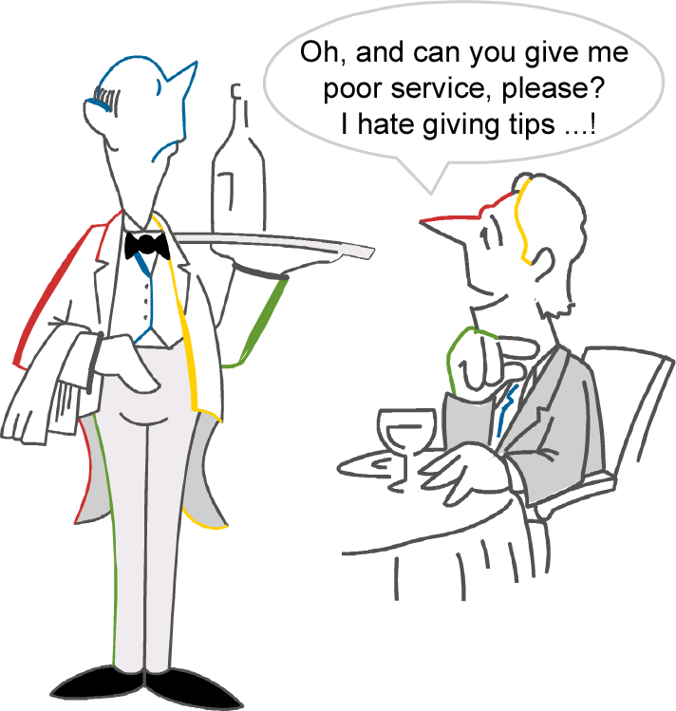
1 Reciprocation
One person is required to repay in kind what another person has provided
The principle of reciprocation says we return favors with favors and not tricks with favors.
“One good turn deserves another”

Slide 7
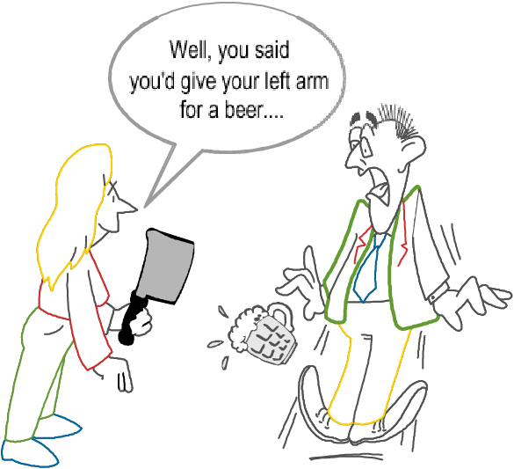
2 Consistency
Most people have a desire to look and be consistent with their words, beliefs, attitudes and deeds because:
Good personal consistency is highly valued by society
Consistent behaviour provides beneficial approach to daily life
“Doing what you said you would do”

Slide 8
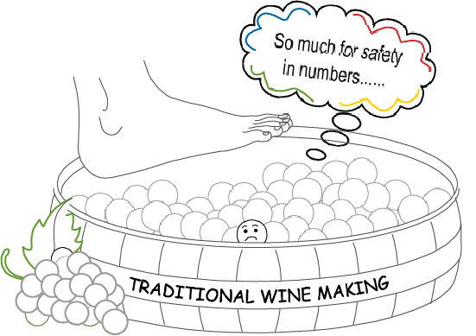
3 Social Proof
People often decide what to do or believe in a certain situation by looking at what other people are doing and believing
“it’s the way things are done around here”

Slide 9
Social Proof
"Like the herd animals we are, we sniff warily at the strange one among us." - Loren Eiseley
“...people look to others and follow what they are doing.”
The principle of social proof is extremely powerful and can convert a defiant individual into agreement.

Slide 10
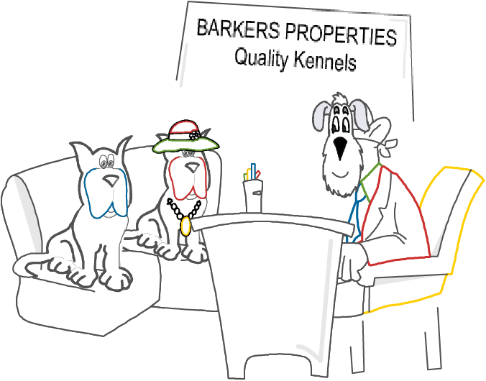
4 Liking
People prefer to say ‘YES’ to those they know and like
“I like you so….why not!”

Slide 11
Liking
"Leadership comes through respect, and a large part of respect is liking someone." – Carol Leonard
The principle of liking says that people will say “yes” more often to those they like.
There are six principles of liking: physical attractiveness, familiarity, compliments, association, cooperation, and similarity.

Slide 12
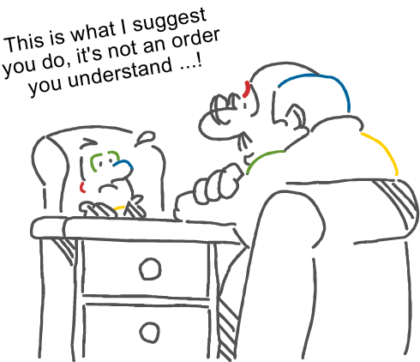
5 Authority
People have a deep-seated obedience and compliance towards requests from authority

Slide 13
Principle of Influence: Authority
The principle of authority states that we are more easily persuaded by those with authority.
The three typical symbols of authority are title, clothing, and perceivable wealth.
  Title can be the occupation's prefix like “doctor” and “professor” or even the occupation's name like , “officer”, “lawyer”, “surgeon”,“trainer”, “gardener”, and “consultant”.
  The second symbol of authority is clothing which consists of all the clothing a person is wearing.
  Lastly, perceivable wealth can consist of the respective person's car, house, jewelery, business, and any other wealth the person being influenced can see.

Slide 14
Principle of Influence: Authority
The law of good continuation in leadership means followers of a leader will “blindly” accept the leader's decisions because of past successes.
  Followers fail to critically think and question the leader's actions because the leader has proven himself in the past to make good decisions. The great Albert Einstein said, “Unthinking respect for authority is the greatest enemy of truth.”
The law of good continuation tells us that you will meet less resistance by most followers you are influencing once you get into the position of influence.

Slide 15
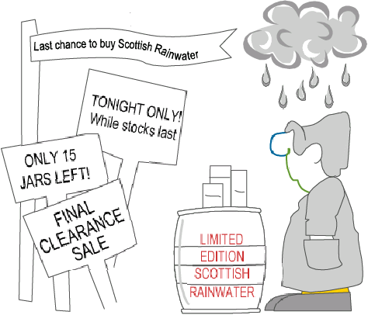
6 Scarcity
According to the scarcity principle, people assign more value to opportunities when they are less available

Slide 16
Principle of Influence: Scarcity
"Forbidden things have a secret charm." - Publius Cornelius Tacitus
The principle of scarcity states that we are more easily persuaded when the resource is limited.
Scarcity is a fundamental principle in economics within the supply and demand curve.

